Slide 1
An Arc-Path Model for OSPF Weight Setting Problem
Dr.Jeffery Kennington
Anusha Madhavan

Slide 2
Agenda
Introduction
Node-Arc Model
Arc-Path Model
Empirical Analysis and Comparison
Conclusion

Slide 3
Introduction
OSPF – Open Shortest Path First
  Interior Gateway Protocol
  Routing Information in an autonomous system
  Link State based Algorithm
    The state of the interface or link is used to decide the path on which the information is routed
    Multiple links with same state is possible. Demand to a destination can be routed on multiple paths.

Slide 4
Routing using OSPF
Routers maintain database with link state information, weights computed using link state, IP address etc.
This database in each router is updated by transmitting Link State Advertisements throughout the autonomous system
A shortest path tree is constructed by each router with itself as the root node and based on weights in the database.

Slide 5
Illustration of OSPF
a
Traffic from a to z =1200
[Weight, Flow]
[1, 600]
Router 1
[1, 600]
Router 2
OC-12, 622 Mbps
[1, 300]
[1, 300]
Router 3
Router 4
Router 5
[2,300]
[2,300]
[3,600]
2488 Mbps
Router 6
OC-48,
z

Slide 6
Disadvantages
Lack of prior knowledge of point to point demands may result in congestion as seen in link OC-12
Updating the weights based on the link state information

Slide 7
Node-Arc Weight Setting Problem
The weight-setting problem as defined by Pioro and Medhi is as follows:
  Given: the network topology, the link capacities, and a set of point-to-point demands
  Find: Weights and flows for each link
  Constraints: the demands must be satisfied, the capacities cannot be violated, and at each node the total entering flow to a given destination is split equally among all out-going links that lie on the shortest paths to that destination.

Slide 8
Illustration of Node-Arc Model
Routing 30 units from Node 2 to Node 7
Routing 10 units from Node 4 to 7
3
15
5
15
+5+7.5
7
1
1
1
15
5+7.5
5+7.5
1
1
1
2
15
4
5+7.5
6
8
1
1
30
10
f_{ij}
l_{ij} =0
c_{ij}=50
i
j
w_{ij}

Slide 9
Illustration of Node-Arc Model
Routing 50 units from Node 2 to 7
1
3
25
5
50
7
1
1
25
25
1
1
2,
5
2
25
4
6
8
1
1
50
f_{ij}
l_{ij} =0
c_{ij}=50
i
j
W_{ij,}
c_{ij}

Slide 10









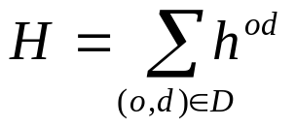
Node-Arc Model Formulation
Definition of sets, parameters and variables
  denotes the set of nodes (routers)
  denotes the set of links (unordered pairs of nodes)
  denotes the set of arcs
  denotes the demand volume to be routed from origin to destination
  denotes the set of pairs such that > 0
  is the sum of demand volumes (i.e.)
Definition of sets, parameters and variables
  denotes the set of nodes (routers)
  denotes the set of links (unordered pairs of nodes)
  denotes the set of arcs
  denotes the demand volume to be routed from origin to destination
  denotes the set of pairs such that > 0
  is the sum of demand volumes (i.e.)

Slide 11






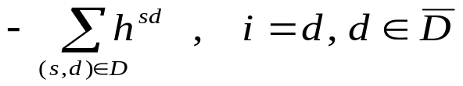
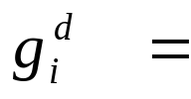



Node-Arc Model Formulation
  Set
  denotes the capacity of arc
  The requirement for commodity at node , denoted by
  is defined below:
otherwise

Slide 12

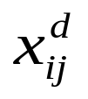










Node-Arc Model Formulation
  denotes the weight on arc
  denotes the flow on arc with destination
  denotes the distance from node to node on the shortest path to node
  denotes the common value of the flow assigned to arcs originating at and contained in shortest paths from to
  The binary decision variable = 1 if arc belongs to the shortest path to node ; else 0

Slide 13
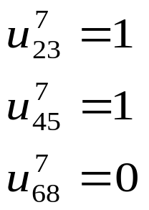
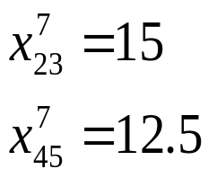
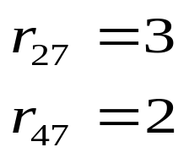
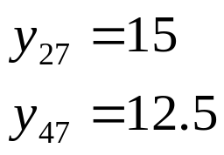
Illustration of Node-Arc Model
Routing 30 units from Node 2 to Node 7
Routing 10 units from Node 4 to 7
3
15
5
15
+5+7.5
7
1
1
1
15
5+7.5
5+7.5
1
1
1
2
15
4
5+7.5
6
8
30
1
10
1
f_{ij}
l_{ij} =0
c_{ij}=50
i
j
w_{ij,}
c_{ij}

Slide 14
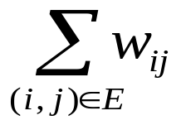
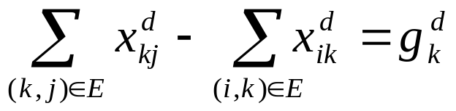
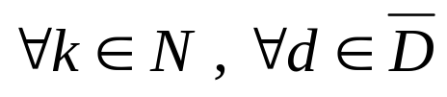
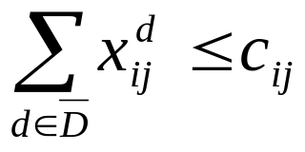

Formulation of Node-Arc Problem
Objective:
    minimize
Constraints:
  The first set of constraints ensures that demand at node is satisfied and ensures the conservation of flow at each node
  The arc capacity constraints are

Slide 15









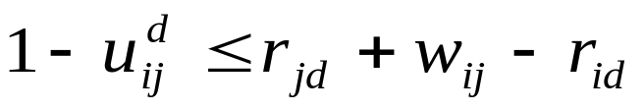

Formulation of Node-Arc Problem (contd.)
  The third set of constraints ensures that flows on shortest paths for each pair are equal.
  The fourth set of constraints prevents flow on any arc that is not in a shortest path for demand node .
  The next set of constraints ensures that the lengths of shortest paths for an pair are equal.

Slide 16


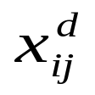






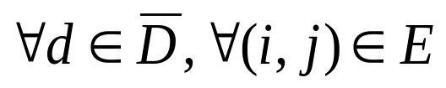
Formulation of Node-Arc Problem (contd.)
  The boundary conditions are:
w_{ij}
1
0
0
0

Slide 17

Arc-Path Weight Setting Problem
The objective is to split the flow equally on limited paths of an demand pair
By limiting the candidate paths, all possible flow combinations can be enumerated
A unique pattern number is assigned to a possible flow distribution in the paths
The selection of a pattern suggests if there is a single or multiple shortest paths for a pair
The weights on the arcs can be computed based on the pattern selection subject to capacity constraints

Slide 18
Illustration of Arc-Path Model
Routing 30 units from Node 2 to Node 7
Routing 10 units from Node 4 to 7
1
3
5
7
2
4
6
8

Slide 19
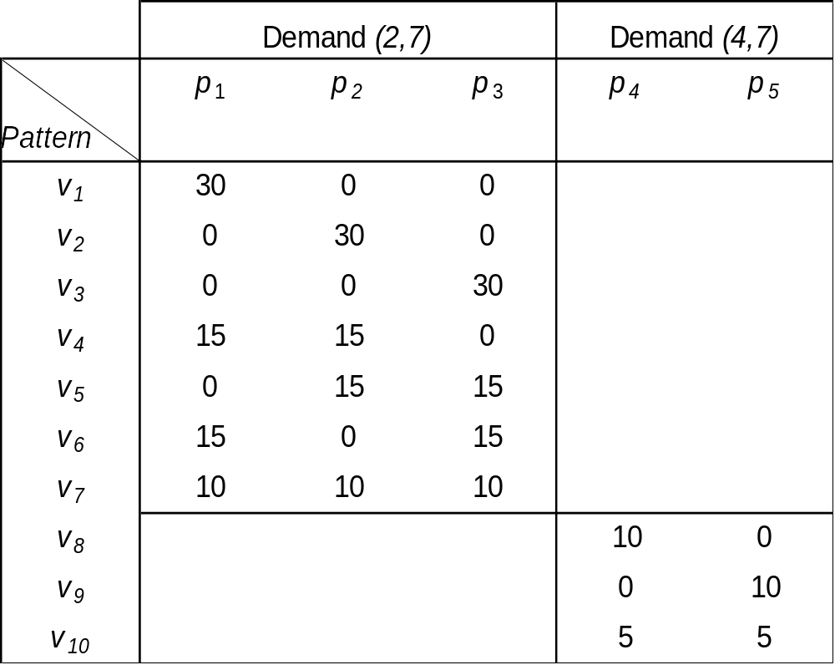





Flow Distribution Pattern for 2 (o,d) Pairs
Candidate Paths
- 2->3->5->7
- 2->4->5->7
- 2->4->6->7
- 4>5->7
- 4->6->7
Patterns v₇ and v₁₀ are selected

Slide 20
Illustration of Arc-Path Model
Routing 30 units from Node 2 to Node 7
Candidate Paths – 2->3->5->7; 2->4->5->7;2->4->6->7
Routing 10 units from Node 4 to 7
Candidate Paths – 4->5->7; 4->6->7
3
10
5
10 +10
+5
7
1
1
1
+5
10
+5
10
10
1
1
1
2
20
4
10
+5
6
8
1
1
30
10
f_{ij}
l_{ij} =0
c_{ij}=50
i
j
w_{ij}

Slide 21


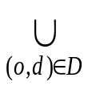









Arc-Path Model Formulation
Definition of sets, parameters and variables
  denotes the set of paths for demand pair
  P = denotes the denote the set of paths computed using the least hops criterion.
  denotes the arcs in path P
  denotes the paths that include arc
  denotes the pattern numbers for each pair
Assumptions
  The demand values for all are equal
  The number of candidate paths for each demand pair is 3 (i.e.)

Slide 22











Arc-Path Model Formulation (contd.)
Definition of sets, parameters and variables
  Set denote the set of patterns that are associated with a single path for demand pair
  Set denote the set of patterns that are associated with two paths for demand pair
  Set denote the set of patterns that are associated with three paths for demand pair
  Let be the path associated with pattern and let set
  Let and be the paths associated with each and let

Slide 23




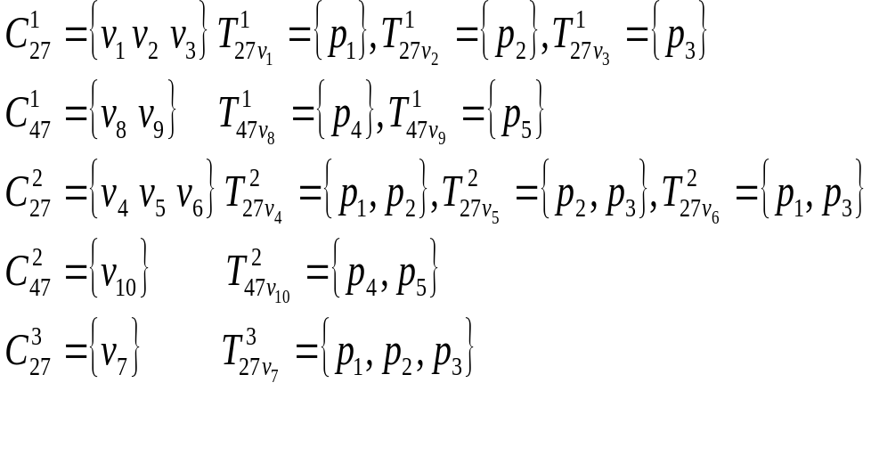
Arc-Path Model Formulation (contd.)
  Let and be the paths associated with each and let

Slide 24









Arc-Path Model Formulation (contd.)
  Let be the set of patterns
  The flow in path P , pattern is stored in matrix
  Let
  Let be the flow of path P
  Let be the length of path P
  The binary variable is 1 if pattern is selected; and 0, otherwise

Slide 25
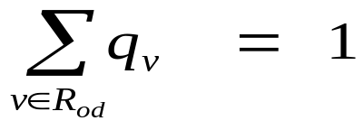

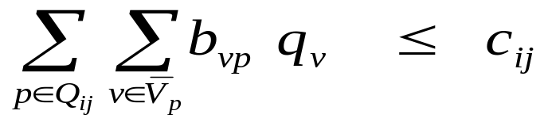

Formulation of Arc-Path Problem
Objective:
    minimize
Constraints:
  The first set of constraints ensures that that only one pattern is selected for each pair.
  The arc capacity constraints are

Slide 26
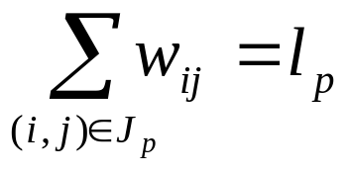



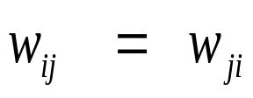

Formulation of Arc-Path Problem (Contd.)
  The third set of constraints calculates the length of each path
  P
  The fourth set of constraints guarantee that the weights on arcs
  The following sets of constraints ensure that if a pattern with flow on a single path is chosen then the length of that path is shortest.
  and are equal

Slide 27
Formulation of Arc-Path Problem (Contd.)
  The following sets of constraints ensure that if a pattern with flow on two paths is chosen then the lengths of those two paths are shortest
  The last sets of constraints ensure that the lengths of multiple paths with flow are equal

Slide 28





Formulation of Arc-Path Problem (Contd.)
The boundary conditions are given below:
  P
and integer

Slide 29
Empirical Analysis
Comparison between node-arc and arc-path models
  The test cases were generated from 6 different networks
  The demand value was fixed at 10 units
  The capacity on the arcs were generated randomly in the range [50,100]
  Each test case had a maximum of 2 hours to compute weights on the arcs

Slide 30
Summary and Conclusions
OSPF algorithm involves developing a shortest path tree by each router with itself as the root node
Data packets to any other router are directed along this shortest path tree.
In this approach the point-to-point demands are disregarded
A node-arc based integer programming model to determine the optimal weights for a given problem instance was presented
The node-arc model balances flow by splitting the incoming flow at a node equally among the outgoing arcs.

Slide 31
Summary and Conclusions
The node-arc model is very difficult to solve
An improved alternative model using an arc-path approach was presented
The arc-path model splits the flow at origin node equally among all the outgoing paths.
The arc-path approach allows the user to restrict the number of candidate paths
Restricting the solution space allows much larger problems to be solved using the arc-path approach

